Slide 1
IPv6 Addressing

Slide 2
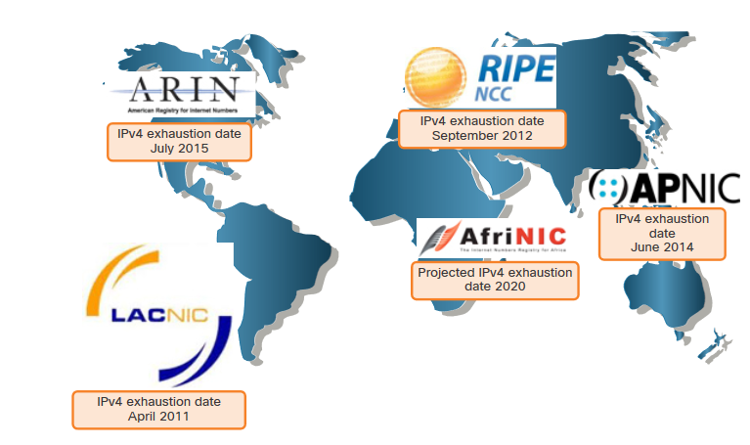
Need for IPv6
IPv4 is running out of addresses. IPv6 is the successor to IPv4. IPv6 has a much larger 128-bit address space.
The development of IPv6 also included fixes for IPv4 limitations and other enhancements.
With an increasing internet population, a limited IPv4 address space, issues with NAT and the IoT, the time has come to begin the transition to IPv6.
Notes:
12 – IPv6 Addressing
12.1 – IPv4 Issues
12.1.1 – Need for IPv6

Slide 3
IPv6 Address Representation
Notes:
12-IPv6 Addressing
12.2 IPv4 Address Representation

Slide 4
IPv6 Addressing Formats
IPv6 addresses are 128 bits in length and written in hexadecimal.
IPv6 addresses are not case-sensitive and can be written in either lowercase or uppercase.
The preferred format for writing an IPv6 address is x:x:x:x:x:x:x:x, with each “x” consisting of four hexadecimal values.
Examples of IPv6 addresses in the preferred format:
          2001:0db8:0000:1111:0000:0000:0000:0200
          2001:0db8:0000:00a3:abcd:0000:0000:1234
Notes:
12 – IPv6 Addressing
12.2 – IPv6 Address Representation
12.2.1 – IPv6 Addressing Formats

Slide 5
Rule 1 – Omit Leading Zero
The first rule to help reduce the notation of IPv6 addresses is to omit any leading 0s (zeros).
  Examples:
01ab can be represented as 1ab
09f0 can be represented as 9f0
0a00 can be represented as a00
00ab can be represented as ab
Note: This rule only applies to leading 0s, NOT to trailing 0s, otherwise the address would be ambiguous.
Type | Format
Preferred | 2001 : 0db8 : 0000 : 1111 : 0000 : 0000 : 0000 : 0200
No leading zeros | 2001 : db8 : 0 : 1111 : 0 : 0 : 0 : 200
Notes:
12 – IPv6 Addressing
12.2 – IPv6 Address Representation
12.2.2 – Omit Leading Zero

Slide 6
Rule 2 – Double Colon
A double colon (::) can replace any single, contiguous string of one or more 16-bit hextets consisting of all zeros.
Example:
2001:db8:cafe:1:0:0:0:1 (leading 0s omitted) could be represented as 2001:db8:cafe:1::1
Note: The double colon (::) can only be used once within an address, otherwise there would be more than one possible resulting address.
Type | Format
Preferred | 2001 : 0db8 : 0000 : 1111 : 0000 : 0000 : 0000 : 0200
Compressed | 2001:db8:0:1111::200
Notes:
12 – IPv6 Addressing
12.2 – IPv6 Address Representation
12.2.2 – Rule 2 – Double Colon
12.2.4 – Activity – IPv6 Address Representation

Slide 7
IPv6 Address Types
Notes:
12-IPv6 Addressing
12.2 IPv4 Address Types

Slide 8
Unicast, Multicast, Anycast
There are three broad categories of IPv6 addresses:
Unicast – Unicast uniquely identifies an interface on an IPv6-enabled device.
Multicast – Multicast is used to send a single IPv6 packet to multiple destinations.
Anycast – This is any IPv6 unicast address that can be assigned to multiple devices. A packet sent to an anycast address is routed to the nearest device having that address.
Note: Unlike IPv4, IPv6 does not have a broadcast address. However, there is an IPv6 all-nodes multicast address that essentially gives the same result.
Notes:
12 – IPv6 Addressing
12.3 – IPv6 Address Types
12.3.1 – Unicast, Multicast, Anycast

Slide 9
IPv6 Address Types
Address Type | Description | Topology
Unicast | “One to One” An address destined for a single interface. A packet sent to a unicast address is delivered to the interface identified by that address.
Multicast | “One to Many” An address for a set of interfaces (typically belonging to different nodes). A packet sent to a multicast address will be delivered to all interfaces identified by that address.
Anycast | “One to Nearest” (Allocated from Unicast) An address for a set of interfaces. In most cases these interfaces belong to different nodes. A packet sent to an anycast address is delivered to the closest interface as determined by the IGP.

Slide 10
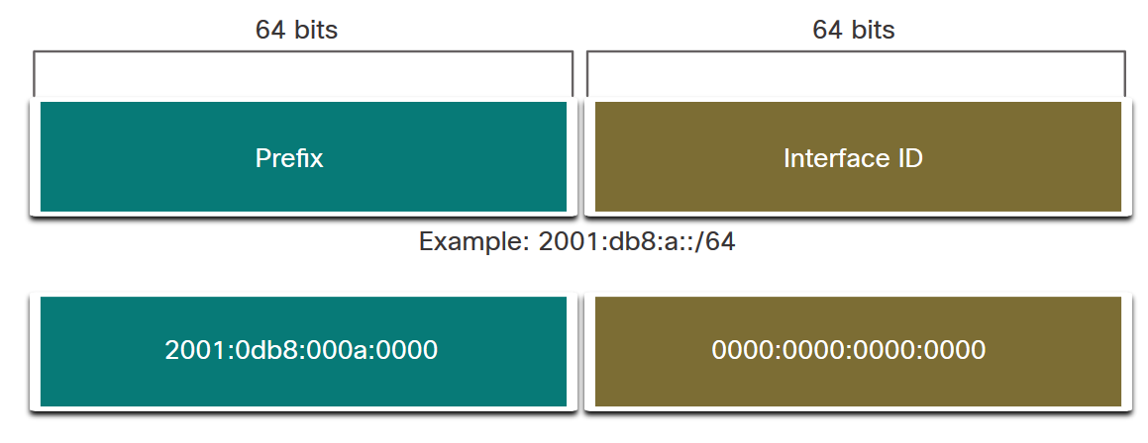
IPv6 Prefix Length
Prefix length is represented in slash notation and is used to indicate the network portion of an IPv6 address.
The IPv6 prefix length can range from 0 to 128. The recommended IPv6 prefix length for LANs and most other types of networks is /64.
Notes:
12 – IPv6 Addressing
12.3 – IPv6 Address Types
12.3.2 – IPv6 Prefix Length

Slide 11
IPv6 Feature Summary
Increased size of address space
Header simplification
Autoconfiguration
  Stateless (RFC 2462) or stateful (DHCPv6)
  Facilitates renumbering
QoS
  Integrated services (int-serv), Differentiated services (diff-serv and RFC2998)
  RFC 3697
IPSec
  As for IPv4
Transition techniques
  Dual stack
  Tunnelling
Notes:
Dual Stack = Devices run IPv4 + IPv6 together.
Tunnelling = IPv6 is "hidden" inside IPv4 packets to cross IPv4-only networks.

Slide 12
IPv6 header
IPv6 header is simpler than IPv4
  IPv4: 14 fields, variable length (20 bytes +)
  IPv6: 8 fields, fixed length (40 bytes)
Header fields eliminated in IPv6
  Header Length
  Identification
  Flag
  Fragmentation Offset
  Checksum
Header fields enhanced in IPv6
  Traffic Class
  Flow Label
Notes:
Dual Stack = Devices run IPv4 + IPv6 together.
Tunnelling = IPv6 is "hidden" inside IPv4 packets to cross IPv4-only networks.

Slide 13
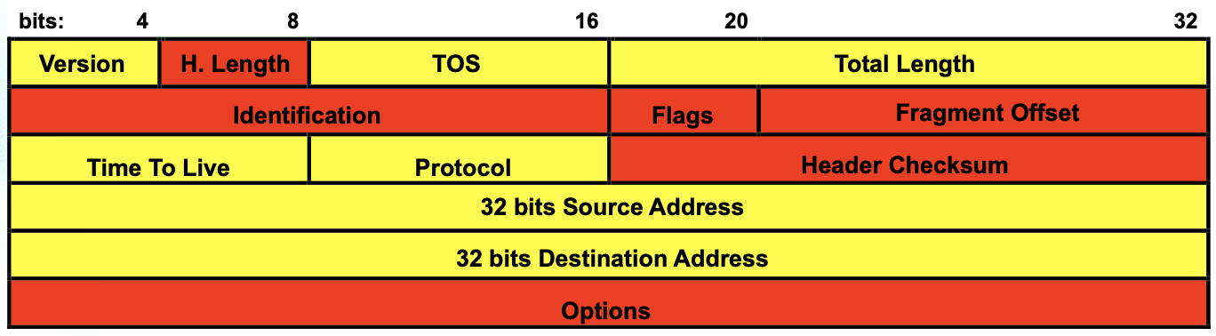
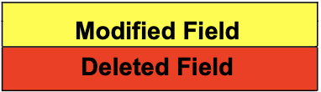
IPv6 vs IPv4 header
Notes:
Dual Stack = Devices run IPv4 + IPv6 together.
Tunnelling = IPv6 is "hidden" inside IPv4 packets to cross IPv4-only networks.

Slide 14
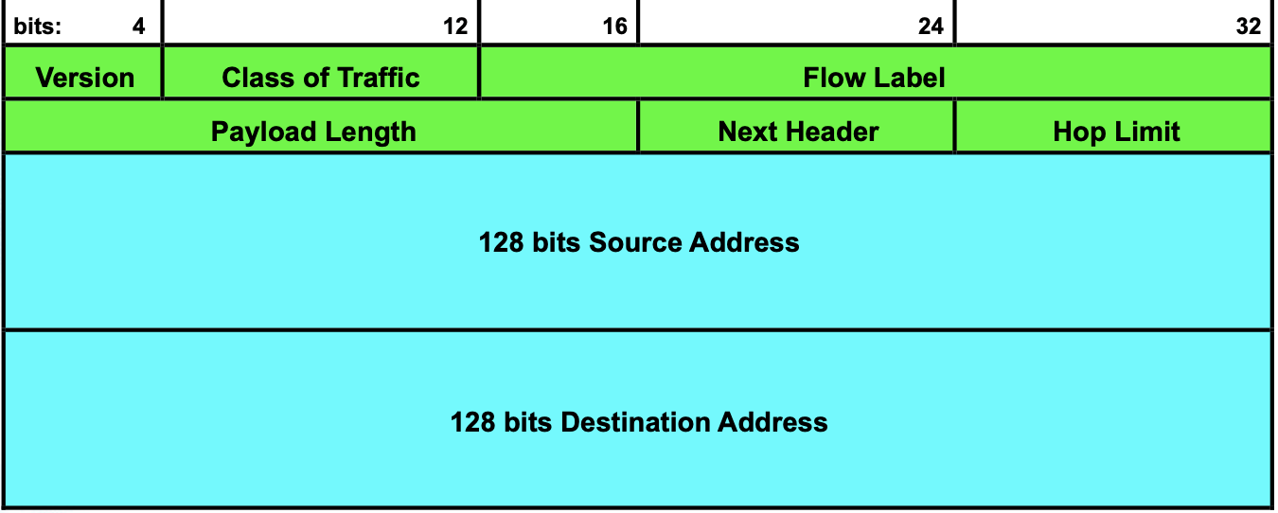
IPv6 vs IPv4 header
The Traffic Class field is an 8-bit field in the IPv6 header.
Similar to the Type of Service (ToS) field in IPv4.
Allows to classify and prioritize packets (e.g., voice, video, file transfer).
Notes:
Dual Stack = Devices run IPv4 + IPv6 together.
Tunnelling = IPv6 is "hidden" inside IPv4 packets to cross IPv4-only networks.

Slide 15
IPv6 Traffic Class
How it works?
The Traffic Class field is divided into two parts (defined by Differentiated Services – DiffServ):
  Differentiated Services Code Point (DSCP, 6 bits): Defines packet priority/quality of service (QoS).
  Explicit Congestion Notification (ECN, 2 bits): Used for congestion control.
So, the Traffic Class = DSCP (6 bits) + ECN (2 bits).
Notes:
Dual Stack = Devices run IPv4 + IPv6 together.
Tunnelling = IPv6 is "hidden" inside IPv4 packets to cross IPv4-only networks.

Slide 16
IPv6 Traffic Class
Using Class of Traffic (examples)
Network devices (routers, switches, firewalls) read this field to decide how to handle packets:
  High priority (e.g., VoIP, video calls) → Low delay, low loss.
  Normal priority (e.g., web browsing).
  Low priority (e.g., file downloads, background updates).
Example values:
101110xx → Expedited Forwarding (for voice).
001010xx → Assured Forwarding (for streaming).
000000xx → Best Effort (default traffic).
Notes:
Dual Stack = Devices run IPv4 + IPv6 together.
Tunnelling = IPv6 is "hidden" inside IPv4 packets to cross IPv4-only networks.

Slide 17
IPv6 Flow Label
Resource Reservation
IPv6 uses the Flow Label field together with the Traffic Class field to identify these flows.
Flow
A flow is defined as a sequence of packets from a source to a destination with the same properties (e.g., same DSCP, same port).
Protocols Used
RSVP (Resource Reservation Protocol): Used to signal and reserve resources along the path.
Notes:
Dual Stack = Devices run IPv4 + IPv6 together.
Tunnelling = IPv6 is "hidden" inside IPv4 packets to cross IPv4-only networks.

Slide 18
IPv6 Flow Label
Resource Reservation
IPv6 uses the Flow Label field together with the Traffic Class field to identify these flows.
IPv6 Field | Purpose in IntServ
Traffic Class | Marks the type/priority of the flow
Flow Label | Identifies a specific flow across the network
IPv6 Fields used by IntServ
Together, these allow routers to recognize flows and provide per-flow QoS guarantees.

